Slide 1
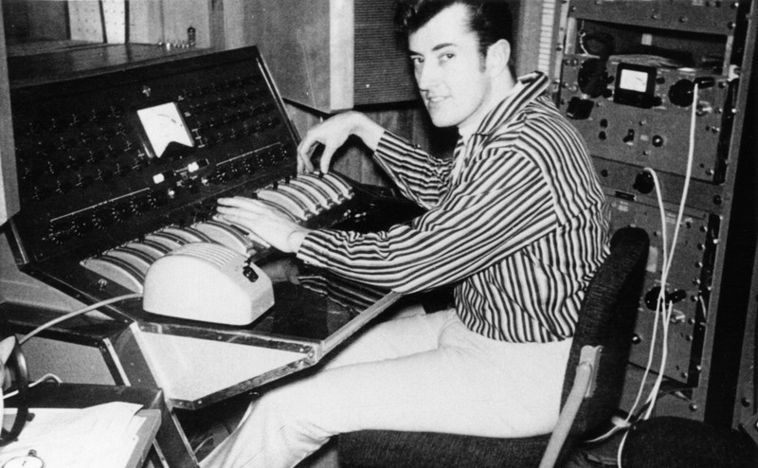
Producers…
Year 13 Music Technology Project

Slide 2
Produce a presentation on one of the producers below.
Brian Wilson
Quincy Jones
George Martin
Roy Thomas Baker
Joe Meek
Dr. Dre
You should include:
Brief history of the producer
Musicians he has worked with
Style of production
Specific techniques or characteristics of production
Some audio/video clips
Presentations to be performed on:
1st July 2014

